Slide 1
Analysis of Twitter data for developing a job vacancy platform in Saudi Arabia

Slide 2
Group Members:
Sultan Alharbi - 1947457
Mishal Almutiri - 1948468
Mohammed Almalki - 1945078

Slide 3
TABLE OF CONTENTS
01
02
03
Introduction Problem & Solution
Proposed system
Results & Evaluations
Implementation
04
05
06
Model Saving
Training Performance Evaluations

Slide 4
Introduction
The last decade is a decade of digital transformation in companies and government around the world. The labor market is among in this transformation. The HR usually use social media to ad their jobs, they can use LinkedIn , Facebook and Twitter. LinkedIn is mostly used by Large and Mid-size companies .Twitter on the other hand, is the most social media used by Saudis, and the Companies use it to ad their products and services.

Slide 5
Problem
The search engine of Twitter is unsuitable search engine. Because it for all kinds of tweets, not like LinkedIn.
When you search on the Twitter search, you will see tweets that are not related to jobs.

Slide 6
Solution
Use of modern NLP techniques to classify job ads from tweets.
Use LSTM , longer memory and thus is better at capturing long range dependencies between the words in an input sequence.
Use arabic data from the Twiterr to train our model.
In Deep Learning the model is trained to know. for example, if this tweet are happy or not.

Slide 7
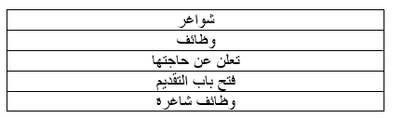
Data Collection
For data generation, the Python library Snscrape was used to scrape Twitter for relevant Tweets.
We used a Different queries.
We have decided to use this list after conducting a brief search on twitter and collecting the phrases that frequently occurs in Twitter job ads.
List of used queries when generating the dataset

Slide 8
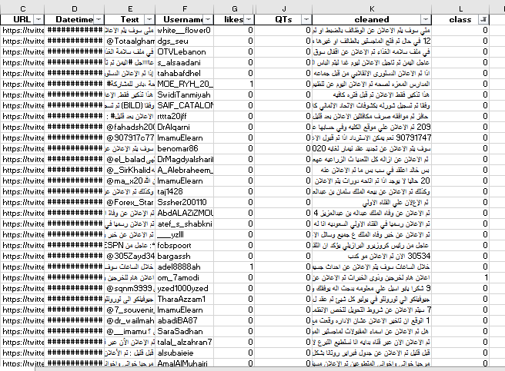
The Dataset

Slide 9
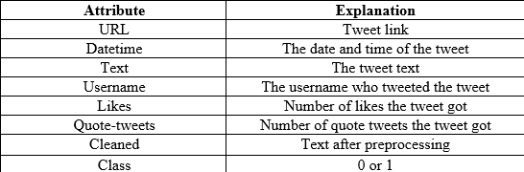
Data dictionary

Slide 10
Proposed system

Slide 11




OUR ENVIRONMENT
PYTHON 3
TENSORFLOW & Keras
JUPYTER
Libraries
Programming language
ML & DL
framework
Interactive python editor
Python library

Slide 12

The Libraries we used:
Numpy: For numeric and matrix operations. Pandas: For data cleaning and manipulation. Sklearn: for predictive data analysis . Matplotlib: For visualizations. PadSequence: ensure that all sequences in a list have the same length. Tokenizer: convert data from text format to bag of words.

Slide 13

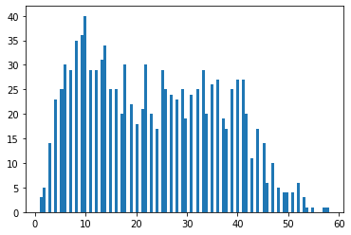
Exploratory Data Analysis
Words count: We needed to plot words count as histogram to know our model max input limit.
X: Number of word in text.
Y: Number of word repetitions.

Slide 14
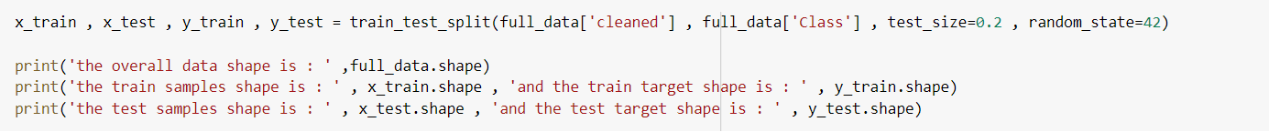

Split data into training and testing
Training
Testing
80%
20%
80% of data is used for training
20% of data is used for testing

Slide 15
Implementation

Slide 16
Implementation steps
Preprocessing and data cleaning
Model building and training
Model evaluation
Model saving and inference

Slide 17
Preprocessing and data cleaning
Normalize Arabic characters.
Remove diacritics.
Remove English words.
Remove repeating characters.
Convert data from text format into bag of words (BoW) & pad-sequences.

Slide 18
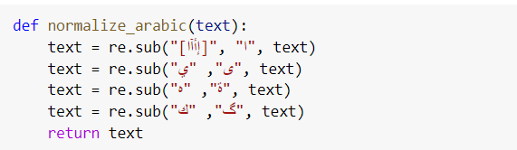
Normalize Arabic characters

Slide 19
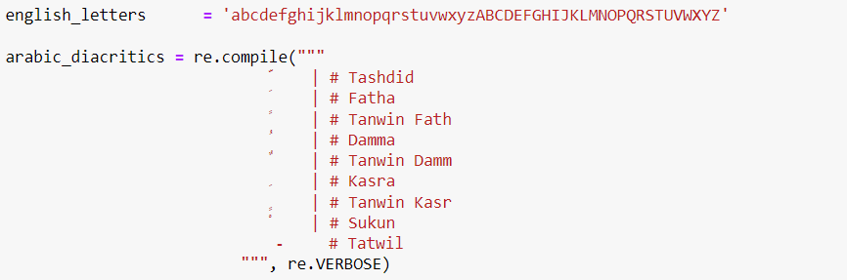
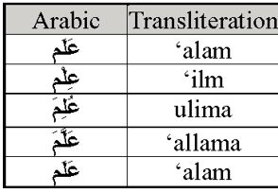
Remove diacritics

Slide 20
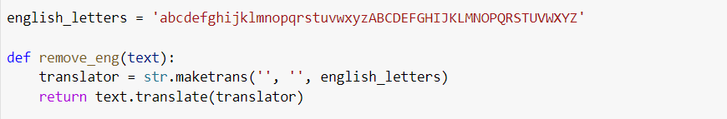
Remove English words

Slide 21

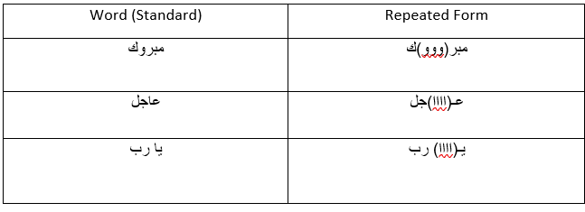
Remove repeating characters

Slide 22
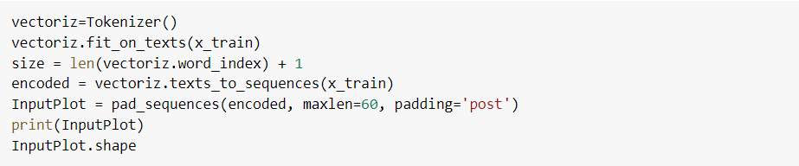
Tokenization and pad-sequences
We do tokenization to convert the input into numbers before feeding into model.
We make pad-sequences to transform the input in same length

Slide 23
Model building and training

Slide 24
Model building and training
Model uses one Embedding layer.
Model input length is 60.
Model uses 2 LSTM layers with 128 and 64 LSTM unit.
Add Dense Layer or Fully Connected Layer
Add dropout layer to decrease overfitting effect.
Apply early stopping to prevent overfitting.
Model has only one output neuron.

Slide 25
Model Hyper-parameters and configurations
Middle Layer Activation Function is Tanh
Output activation function is sigmoid
Optimizer is Adam with learning rate of 0.0001
Model trained for 20 epochs

Slide 26
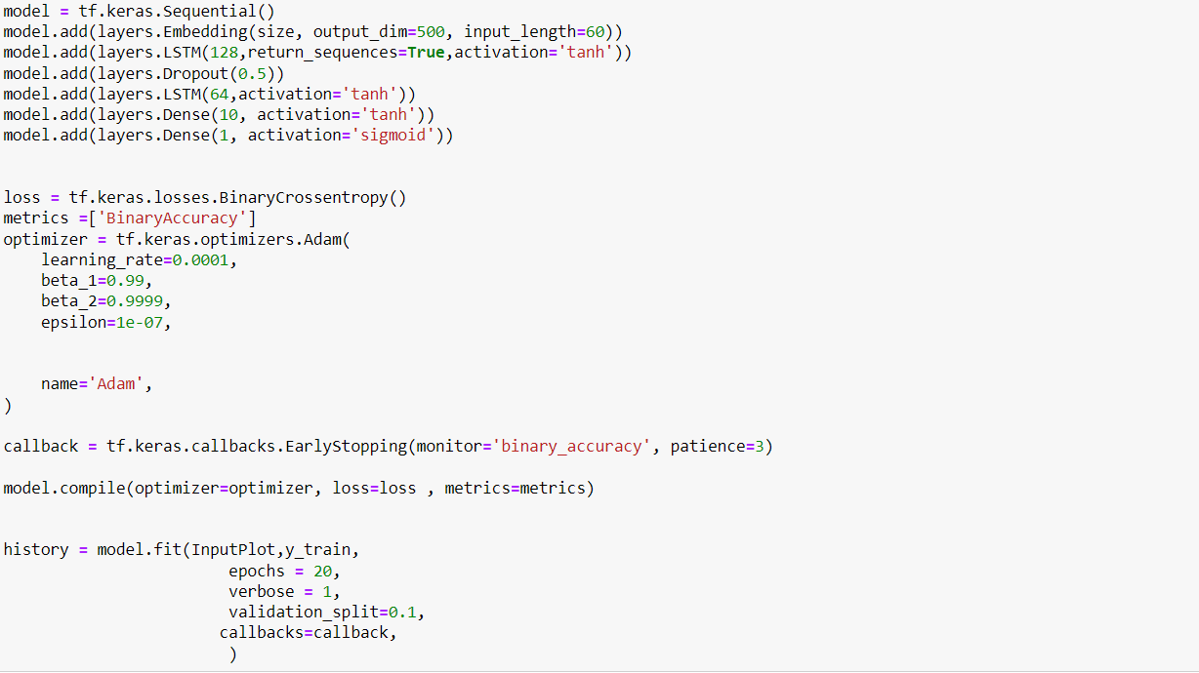
Model

Slide 27
Training Performance Evaluations

Slide 28
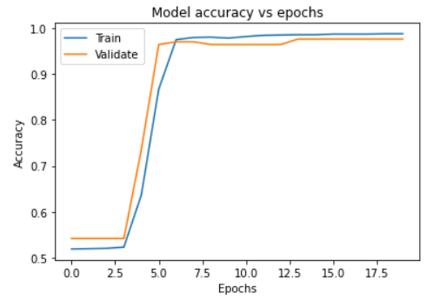
Training Accuracy
The Model achieved 0.9819 Accuracy in training .

Slide 29
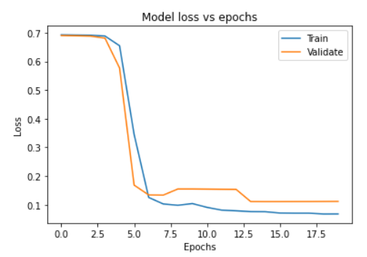
Training Loss
Loss is less than 0.2 in training.

Slide 30
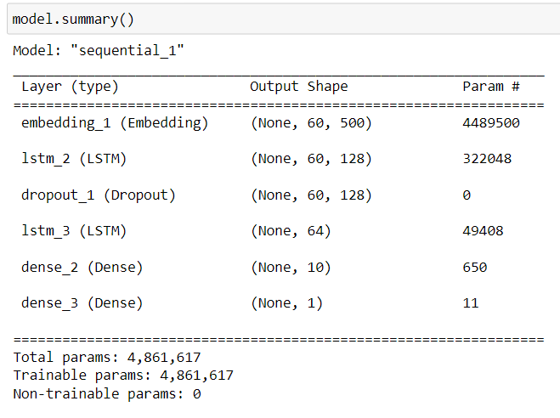
Model Architecture Summary

Slide 31
Results
And Evaluations

Slide 32
Evaluation Metrics
Since our goal is to classify tweets as job ads or not, We need to use classification metrics to evaluate our final model.
Accuracy
Precision
Recall
F1-score

Slide 33




Accuracy evaluation
Precision evaluation
It measures how many text , both positive and negative, were correctly classified.
It measures how many text predicted as positive are in fact positive.
Recall evaluation
F1_score evaluation
It measures how many text out of all positive have we classified as positive.
It’s the mean between Precision and Recall.

Slide 34
RESULTS
 | VALUE | SET TYPE | DESCRIPTION
precision | 0.9661 | test | This number indicated that false positives is low.
recall | 0.9664 | test | This number indicated that false negatives is also low
f1 score | 0.9663 | test | Combination of precision and recall
Accuracy | 0.9663 | test | Correct classification %

Slide 35
Model Saving

Slide 36
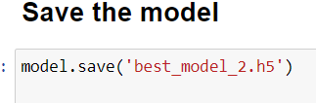
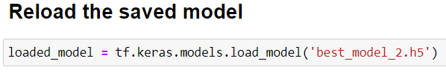
Model saved as h5 format
The model has been saved in H5 format so that we don't have to Run and train on every time for upcoming projects that depend on the model.

Slide 37
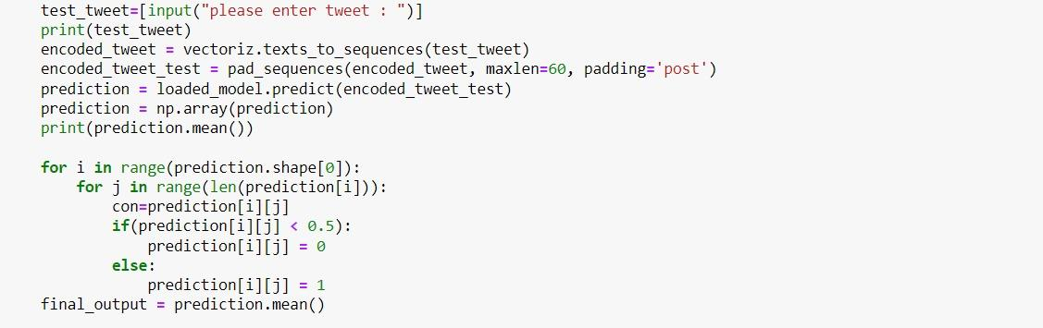
Model Manual Test
We wanted to make sure that our model is doing a good job, so we tested it by our own words.

Slide 38
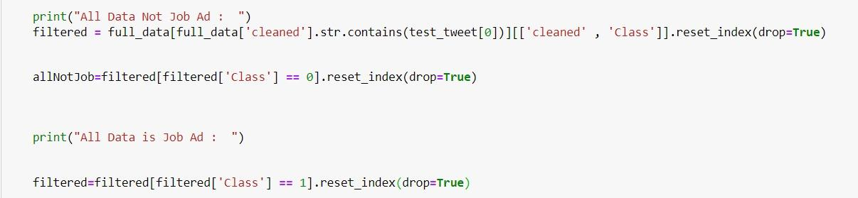
Search and Recommendations
We wanted to make sure that our model is doing a good job, so we tested it by our own words.

Slide 39
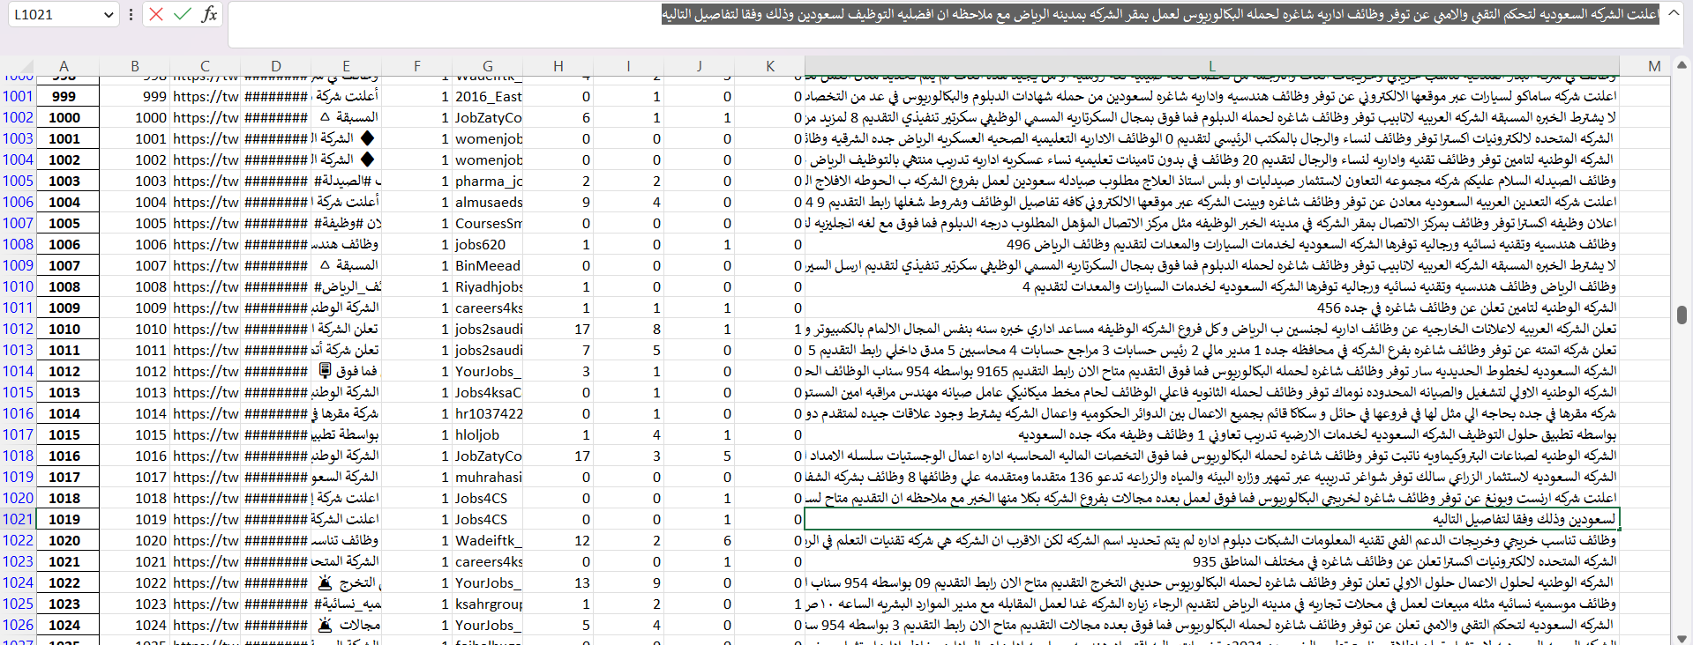
Example From Our Data

Slide 40
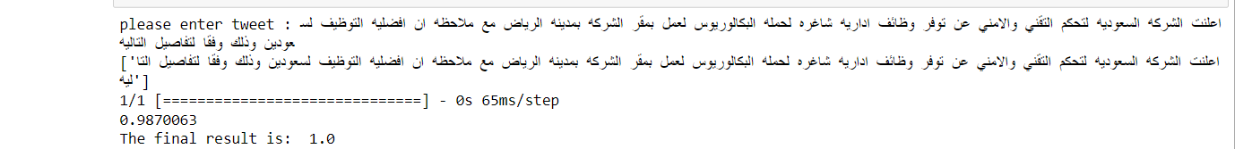
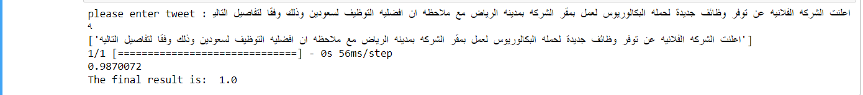
Model Manual Test

Slide 41
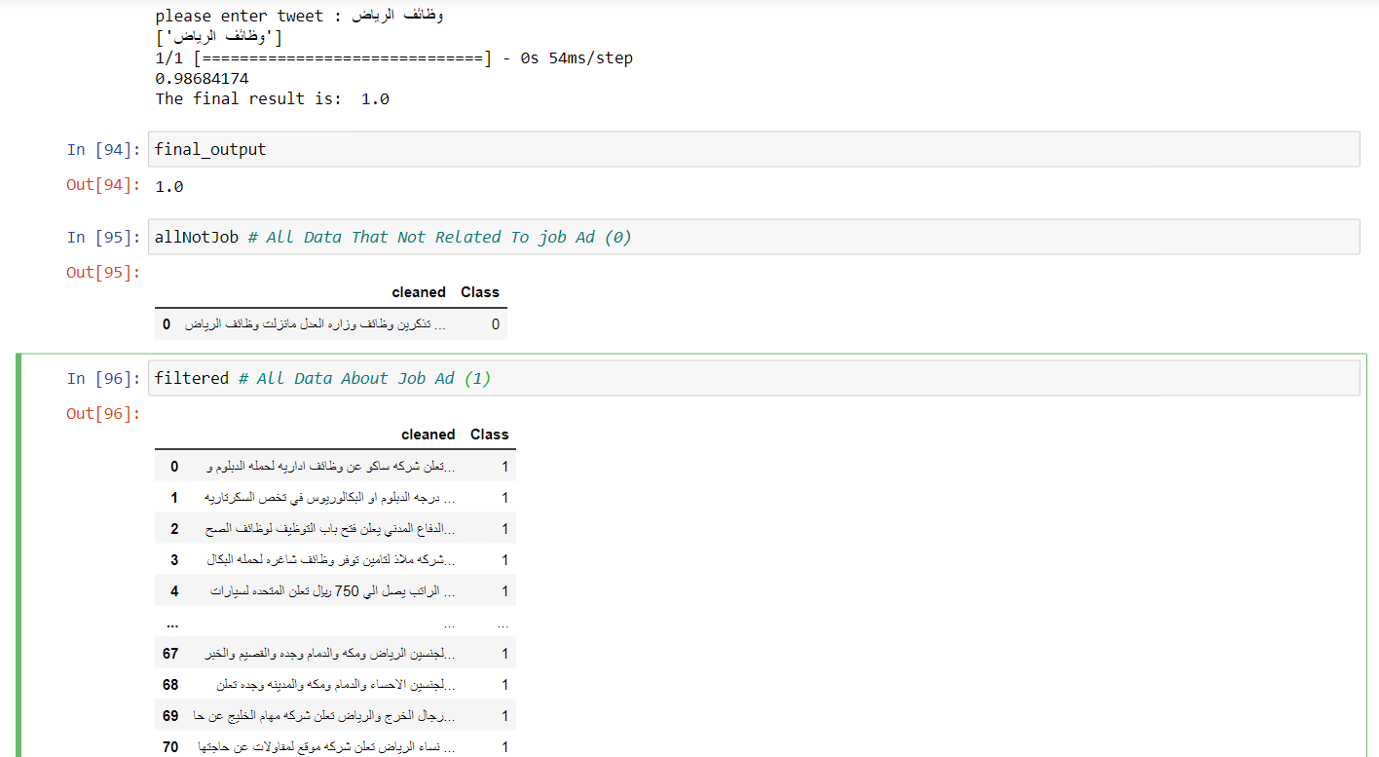
Search and Recommendations with model Example

Slide 42
Thank You

